Slide 1
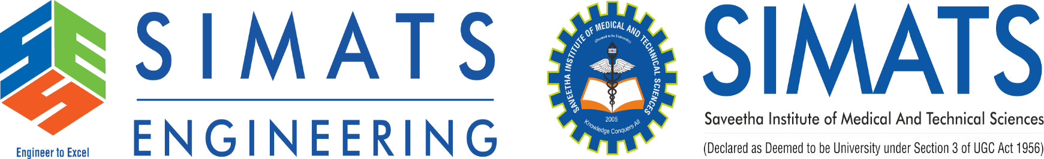
AI-POWERED SMART REQUIREMENT ANALYZER FOR SE AND AUTOMATED SRS GENERATION
CSA1062-Software Application for version control
Presented by
T Gnaneswari 192372183 R Thrisha 192373045 G Mythili 192372250
Guide by
Dr Radhika S
Dr Sarala V

Slide 2
ABSTRACT
Software Requirement Specification (SRS) is a critical document in software development.
Traditional requirement gathering and documentation processes are time-consuming, error-prone, and often lead to ambiguities.
The proposed AI-Powered Smart Requirement Analyzer utilizes Artificial Intelligence and Natural Language Processing (NLP) techniques to analyses user requirements automatically and generate structured SRS documents.
The system identifies functional and non-functional requirements, detects inconsistencies, suggests improvements, and generates standardized IEEE-compliant SRS reports.
This reduces manual effort, improves requirement quality, and accelerates software development life cycles.
Keywords: Artificial Intelligence, NLP, Requirement Engineering, SRS Generation, Software Engineering.

Slide 3
INTRODUCTION
Requirement Engineering is one of the most important phases in Software Development Life Cycle (SDLC). Poorly defined requirements often result in project delays, increased costs, and software failures.
Current challenges include:
Ambiguous requirement descriptions
Incomplete documentation
Human errors during analysis
Time-consuming SRS preparation
The proposed system leverages:
Artificial Intelligence (AI)
Natural Language Processing (NLP)
Machine Learning Techniques
To automatically analyses requirements and generate comprehensive Software Requirement Specification (SRS) documents.

Slide 4
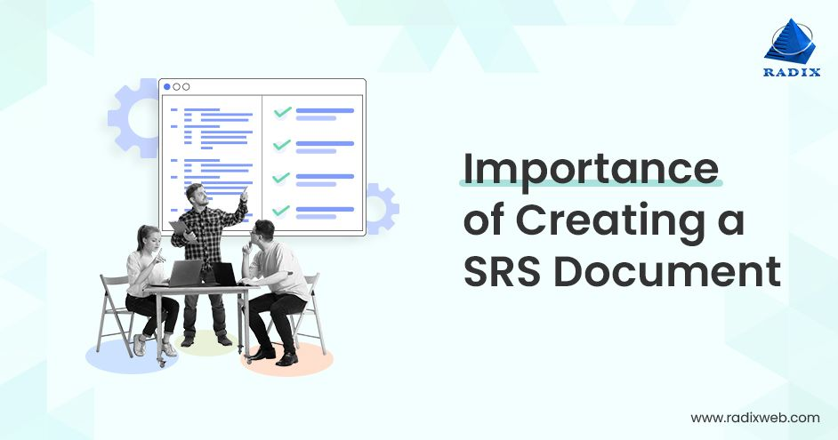
PROBLEM STATEMENT
Software development teams often collect requirements in unstructured formats such as emails, meeting notes, or client descriptions.
This creates issues such as:
Requirement ambiguity
Missing functional requirements
Inconsistent documentation
Increased project risks
Delays in SRS preparation
Expected Benefits
✔ Faster Requirement Processing ✔ Improved Accuracy ✔ Reduced Human Errors ✔ Automated SRS Generation ✔ Increased Development Efficiency

Slide 5
LITERATURE REVIEW
Author | Year | Title of Paper | Tools / Technologies | Research Gap
Zhang et al. | 2025 | AI-Based Requirement Analysis Using NLP | NLP, BERT, Python | Limited support for automatic SRS generation
Sharma & Gupta | 2025 | Automated Requirement Engineering Framework | Machine Learning, Text Mining | Lacks real-time requirement validation
Lee et al. | 2024 | Intelligent Software Requirement Processing System | GPT Models, Deep Learning | High computational cost and complexity
Kumar et al. | 2024 | Smart SRS Generation Using AI Techniques | NLP, TensorFlow | Limited handling of non-functional requirements
Patel & Singh | 2023 | Requirement Extraction from Natural Language Documents | NLP, Named Entity Recognition | Does not provide standardized IEEE SRS output

Slide 6
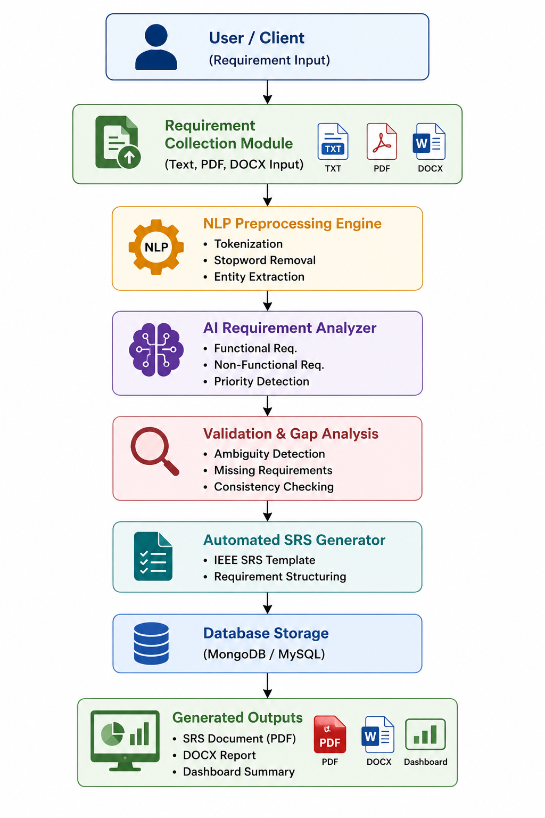
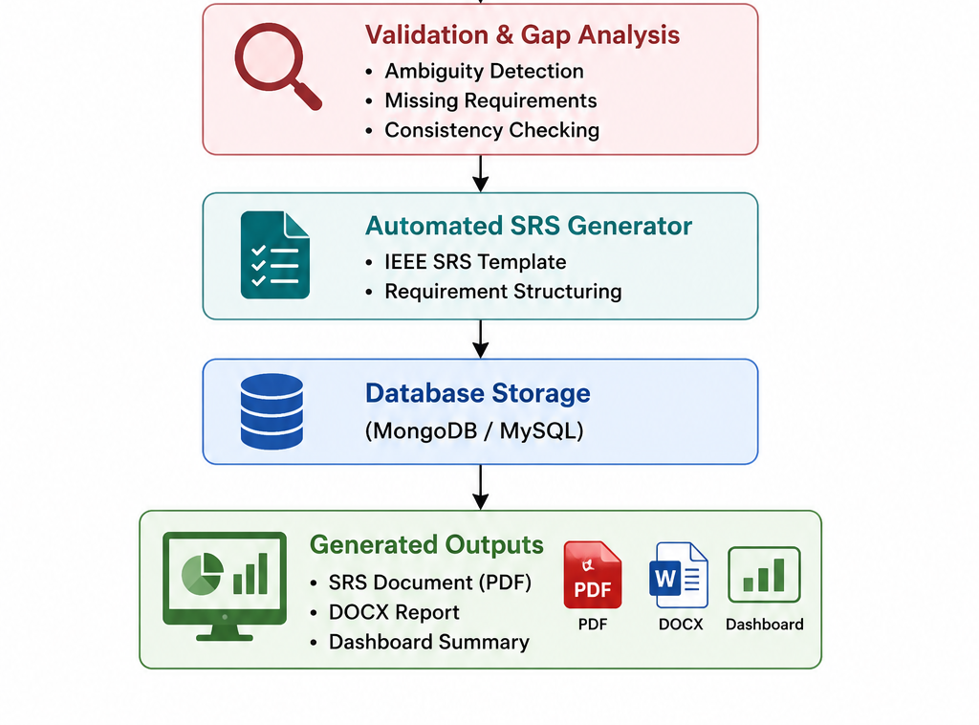
SYSTEM ARCHITECTURE

Slide 7
Module 1 – Requirement Collection and Analysis
Objective
To collect software requirements from users and analyze them using AI and NLP techniques.
Functionality
Accepts requirements in Text, PDF, or DOCX formats.
Extracts important information from user inputs.
Identifies Functional Requirements (FR) and Non-Functional Requirements (NFR).
Removes duplicate and irrelevant information.
Detects keywords, entities, and system features.
Technologies Used
Python
Natural Language Processing (NLP)
Machine Learning Models

Slide 8
Module 2 – Requirement Prioritization and Risk Analysis
Objective
To prioritize requirements and identify potential project risks.
Functionality
Assigns priority levels (High, Medium, Low).
Analyzes requirement dependencies.
Detects ambiguous and conflicting requirements.
Identifies missing or incomplete requirements.
Performs risk assessment based on complexity and impact.
Technologies Used
AI-based Decision Models
Risk Assessment Algorithms
Priority Ranking Techniques

Slide 9
Module 3 – UML and SRS Generation
Objective
To automatically generate UML diagrams and Software Requirement Specification (SRS) documents.
Functionality
Converts analyzed requirements into UML diagrams.
Generates Class Diagrams ,Activity Diagrams and Use Case Diagrams.
Creates IEEE-standard SRS documentation.
Exports reports in PDF and DOCX formats.
Technologies Used
PlantUML
AI-based Document Generator
Python PDF/DOCX Libraries

Slide 10
CONCLUSION
The AI-Powered Smart Requirement Analyzer for Software Engineering and Automated SRS Generation is designed to simplify and automate the requirement engineering process. By leveraging Artificial Intelligence and Natural Language Processing techniques, the system efficiently collects, analyzes, and classifies software requirements while identifying ambiguities and potential risks. It further automates the generation of UML diagrams and IEEE-standard Software Requirement Specification (SRS) documents, reducing manual effort and improving documentation quality. The proposed solution enhances accuracy, saves time, minimizes human errors, and supports better decision-making throughout the software development lifecycle. Overall, this project demonstrates the potential of AI-driven technologies in creating a smarter, faster, and more reliable approach to software requirement management and documentation.

Slide 11
FUTURE SCOPE
The proposed AI-Powered Smart Requirement Analyzer can be enhanced with advanced AI and software engineering features in the future.
Future Enhancements
Integration with Large Language Models (LLMs) for more accurate requirement understanding.
Automatic generation of Test Cases from requirements.
Real-time collaboration for multiple stakeholders.
Support for Agile User Stories and Product Backlogs.
Requirement Traceability Matrix (RTM) generation.
Integration with project management tools such as Jira and Trello.
Multi-language requirement analysis and SRS generation.
Cloud-based deployment for enterprise-scale projects.

Slide 12
REFERENCES
Y. Zhang, H. Wang, and J. Liu, “AI-Based Requirement Analysis Using NLP,” International Journal of Software Engineering and Applications, vol. 15, no. 2, pp. 45–58, 2025.
R. Sharma and P. Gupta, “Automated Requirement Engineering Framework Using Machine Learning,” IEEE Access, vol. 11, pp. 78945–78958, 2025.
S. Kumar, A. Verma, and R. Singh, “Smart SRS Generation Using AI Techniques,” Journal of Systems and Software, vol. 205, pp. 111–123, 2024.
M. Lee, J. Park, and S. Kim, “Intelligent Software Requirement Processing System,” IEEE Transactions on Software Engineering, vol. 50, no. 4, pp. 876–889, 2024.
K. Patel and D. Singh, “Requirement Extraction from Natural Language Documents Using NLP and NER,” International Journal of Advanced Computer Science and Applications, vol. 16, no. 1, pp. 112–120, 2023.
M. A. Umar and K. Lano, “Advances in Automated Support for Requirements Engineering: A Systematic Literature Review,” Requirements Engineering, vol. 30, no. 1, pp. 1–28, 2023.

Slide 13


